Slide 1
Acceptance and
Integration Testing
Prof. Dr. Dirk Riehle
Friedrich-Alexander University Erlangen-Nürnberg
ADAP B03
Licensed under CC BY 4.0 International
Notes:
It is Friedrich-Alexander University Erlangen-Nürnberg – FAU, in short.
Corporate identity wants us to say “Friedrich-Alexander University”.

Slide 2
Types of Tests [1] (Recap)
Components tests (a.k.a. unit tests)
  Focus on testing one component out of context
Acceptance tests (a.k.a. functional tests)
  Focus on testing one cross-cutting functionality
Integration tests (a.k.a. system tests)
  Focus on testing end-to-end system integrity
[1] This is a simplification for the purposes of this course.

Slide 3
Acceptance Tests
Object under test is the system or a non-trivial subsystem
  This is in contrast to unit testing, which isolates one component
The tests focus on the system’s observable functionality
  The PRD (product backlog) serves as the specification
Test set-up has to cordon off rest of the system

Slide 4
Tell-a-Friend Acceptance Test
public void testTellFriendMakeWebPart() {
Map<String, String> args = new HashMap<String, String>();
...
args.put(TellFriendFormHandler.EMAIL_SUBJECT, "Oh well...");
handler.handlePost(session, args);
part = handler.makeWebPart(session);
assertEquals(part.getValue(TFFH.EMAIL_SUBJECT), "Oh well...");
}
public void testTellFriendPost() {
EmailAddress from = EmailAddress.getFromString("i@w.org");
EmailAddress to = EmailAddress.getFromString("fan@yahoo.com");
String subject = "Coolest website ever!";
...
Map<String, String> args = new HashMap<String, String>();
args.put(TellFriendFormHandler.EMAIL_FROM, from.asString());
args.put(TellFriendFormHandler.EMAIL_TO, to.asString());
args.put(TellFriendFormHandler.EMAIL_SUBJECT, subject);
args.put(TellFriendFormHandler.EMAIL_BODY, body);
handler.handlePost(session, args);
}

Slide 5
Test Set-up Example (JUnit 3.8)
public class HandlerTestSetup extends TestSetup {
public UserSession session;
protected void setUp() throws Exception {
super.setUp();
session = createUserSession();
ContextManager.setThreadLocalContext(session);
Test test = getTest();
if (test instanceof HandlerTest) {
HandlerTest handlerTest = (HandlerTest) test;
handlerTest.setUserSession(session);
}
}
protected UserSession createUserSession() {
Wahlzeit.configurePartHandlers();
UserSession result = new UserSession("testContext");
...
result.setConfiguration(LanguageConfigs.get(Language.ENGLISH));
return result;
}
}

Slide 6
How to Write Acceptance Tests
Think from specification (through user interface)
Sequentially test all relevant parameters
Cover all functional edge cases

Slide 7
Tell-a-Friend Acceptance Test Example
public void testTellFriendMakeWebPart() {
Map<String, String> args = new HashMap<String, String>();
...
args.put(TellFriendFormHandler.EMAIL_SUBJECT, "Oh well...");
handler.handlePost(session, args);
part = handler.makeWebPart(session);
assertEquals(part.getValue(TFFH.EMAIL_SUBJECT), "Oh well...");
}
public void testTellFriendPost() {
EmailAddress from = EmailAddress.getFromString("i@w.org");
EmailAddress to = EmailAddress.getFromString("fan@yahoo.com");
String subject = "Coolest website ever!";
...
Map<String, String> args = new HashMap<String, String>();
args.put(TellFriendFormHandler.EMAIL_FROM, from.asString());
args.put(TellFriendFormHandler.EMAIL_TO, to.asString());
args.put(TellFriendFormHandler.EMAIL_SUBJECT, subject);
args.put(TellFriendFormHandler.EMAIL_BODY, body);
handler.handlePost(session, args);
}
RATHER
PAINFUL

Slide 8
Model-View-Separation and Testing
Model-view-separation
  Cleanly separates the domain model from it user interface(s)
  Is a common simplification of the MVC pattern
  Significantly simplifies functional testing of domain model
Programmatic testing needs a clean model interface (API)
  API = application programming interface
  Wahlzeit provides a clean in-Java interface
  Better would be a language independent API

Slide 9
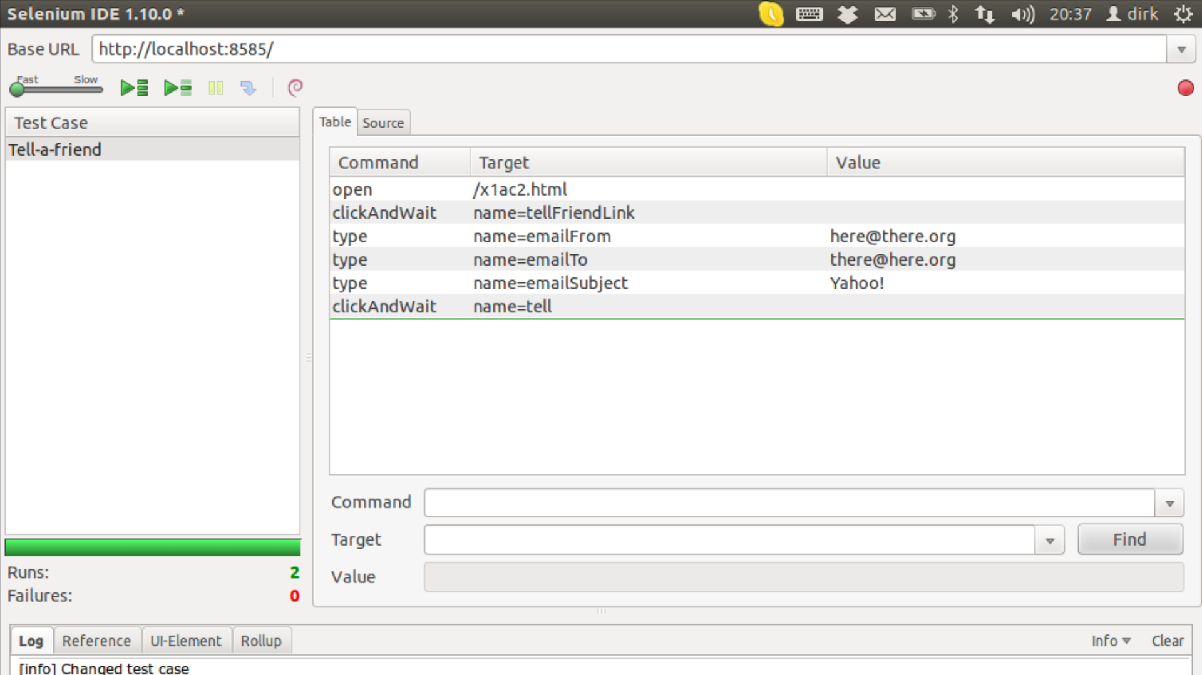
Scripted Acceptance Tests

Slide 10
Advanced Testing Concepts (Recap)
Handling complex system set-ups
  Mocking, stubbing, nulling
  Dependency injection
Testing specific system aspects
  Concurrency
  Legacy code
Test structure and practicality
  Extent of tests run, run-time

Slide 11


Slide 12
Review / Summary of Session
Acceptance and integration tests
Ways of implementing these tests
Challenges of complex testing

Slide 13
Thank you! Questions?
dirk.riehle@fau.de – http://osr.cs.fau.de
dirk@riehle.org – http://dirkriehle.com – @dirkriehle
DR

Slide 14
Credits and License
Original version
  © 2012-2020 Dirk Riehle, some rights reserved
  Licensed under Creative Commons Attribution 4.0 International License
Contributions
  ...

